Slide 1
P. H .DEEPIKA
Final Project

Slide 2

KEYLOGGER AND SECURITY

Slide 3


AGENDA
Introduction
Problem Statement
Project Overview
Who Are The End Users
Solution and Value Proposition
The "Wow" in Our Solution
Modelling
Results
Project Link

Slide 4
INTRODUCTION
What is a keylogger?
Keyloggers are a type of spyware malware designed to spy on victims. Because they can capture everything you type, keyloggers are one of the most invasive forms of malware.
There are two main types of keyloggers: software and hardware. Keylogger software is more common than keylogger hardware, because the latter requires actual physical access to a device.

Slide 5


Hardware keylogger :
Hardware-based keyloggers take the form of a physical device, like a USB stick or another item that may look similar to a charger.
They record keystrokes and other data, to be retrieved later by a hacker.
They cannot be detected by any anti –virus software
Software keylogger :
Keylogger software is usually malicious
But some companies and parents use it to keep tabs on employees and kids.
Depending on their application, time-tracking software and parental monitoring apps can easily verge into spying territory.

Slide 6

PROBLEM STATEMENT
What keylogger do?
Record all your keystrokes, including your passwords and banking details.
Record both sides of conversations in messaging apps and emails.
Record your browsing history
Take screenshots when certain keywords are typed.
Take remote control over your device.
Remotely log in or out of your device.
Record how long you use specific apps.
Print or email logs back to the hacker.
Hide in the background.

Slide 7

PROJECT OVERVIEW
Comprehensive Understanding the keyloggers and their types
working of keylogger in real time and types of keylogger attacks
Loss caused by the keylogger attacks
Effective safety measures to prevent keylogging attacks
3/21/2024 Annual Review

Slide 8

WHO ARE THE END USERS?
Keyloggers are even used for legitimate purposes etc.
The users are:
Companies: Some companies use keyloggers to track which apps employees use, and how they are using their time.
Hackers: When most people think of keyloggers, they think of hackers
Parents: Some parental monitoring software is essentially spyware or even a keylogger. While it’s legal for parents to monitor their under-age children
“““ End users are the individuals within an organization who interact with various digital platforms, applications, and devices daily. They are often the first line of defense against cyber threats ”””
3/21/2024 Annual Review

Slide 9
YOUR SOLUTION AND ITS VALUE PROPOSITION
Anti-virus :The best way to protect your devices from keylogging is to use a high-quality antivirus You can also take other precautions to make an infection less likely.
Password manager : You may use a password manager to generate highly complex passwords In many cases, these programs are able to auto-fill your passwords, which allows you to bypass using the keyboard altogether.
Asterisks : If you are not typing, a keylogger cannot record any strokes, and since password characters are usually replaced by asterisks, even a video surveillance system would not be able to figure out what was entered.
Two step authetntication : In addition, use two step verification when you have the option. A keylogger may deduce your password, but the second phase of the authentication process may deter them.
A virtual keyboard can also help prevent keyloggers from accessing your keystrokes.

Slide 10

THE WOW IN YOUR SOLUTION
Impact: Significant reduction in the likelihood of keylogging attacks through proactive measures.
Innovative Approach: Combining technical measures with user education for comprehensive protection.
Demonstration: Real-time demonstration of a simple keylogger to illustrate the threat and the effectiveness of security measures.
10

Slide 11
MODELLING :
Before we begin ,we need to install python and some particular libraries of python in the system which can installed by the commands in command prompt
pip install pynput
pip install sons
Pynput helps in read keystrokes as the user types in stuff Jsons is a lnter changing format which often exchange data between a webserver and user agent
Initialization of keylogger : Set up the main GUI window. Initialize global variables for key logging.
Event Capturing of keystrokes : Start capturing key events when the "Start" button is pressed. Log key press and release events.
Data Logging into text files : Continuously update text and JSON log files with captured key events.
Stop Logging : Stop capturing key events when the "Stop" button is pressed. Update the GUI status to indicate the keylogger is stopped.
11

Slide 12

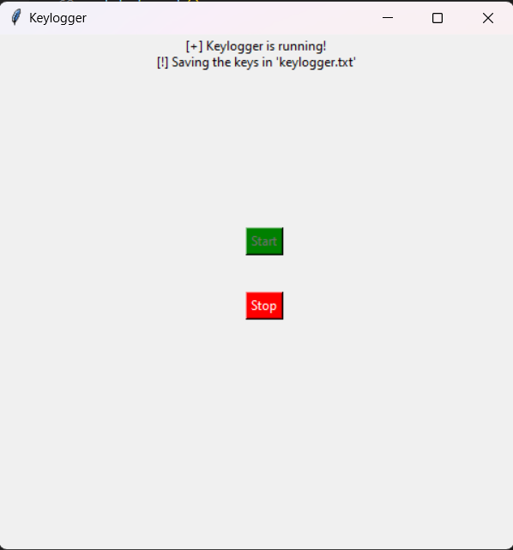
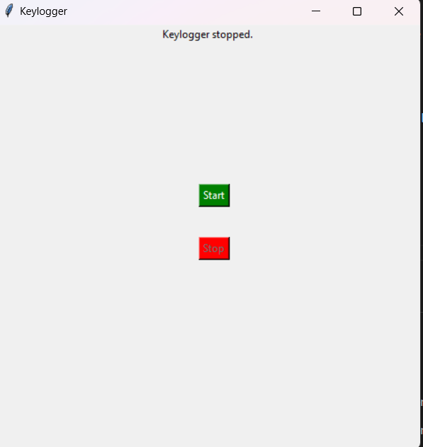
Wire Frames :
STEP 1
STEP 2
STEP 3
Step 1 : The start button initialize to start keylogging in the machine
Step 2 : As the keylogger running it saves the keys in keylogger.txt file
Step 3 : The keylogger stops and keys has been saved in the text document file

Slide 13
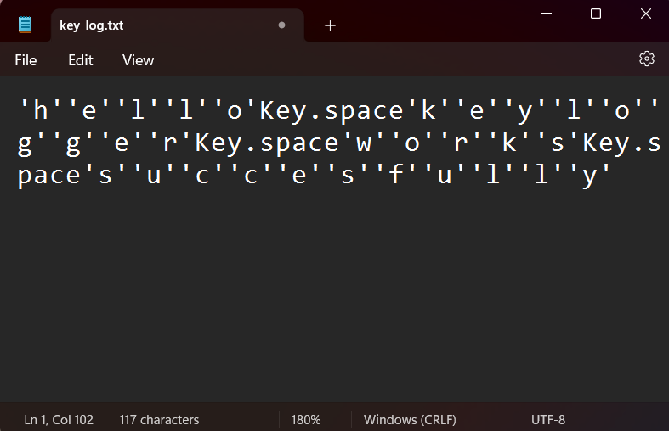
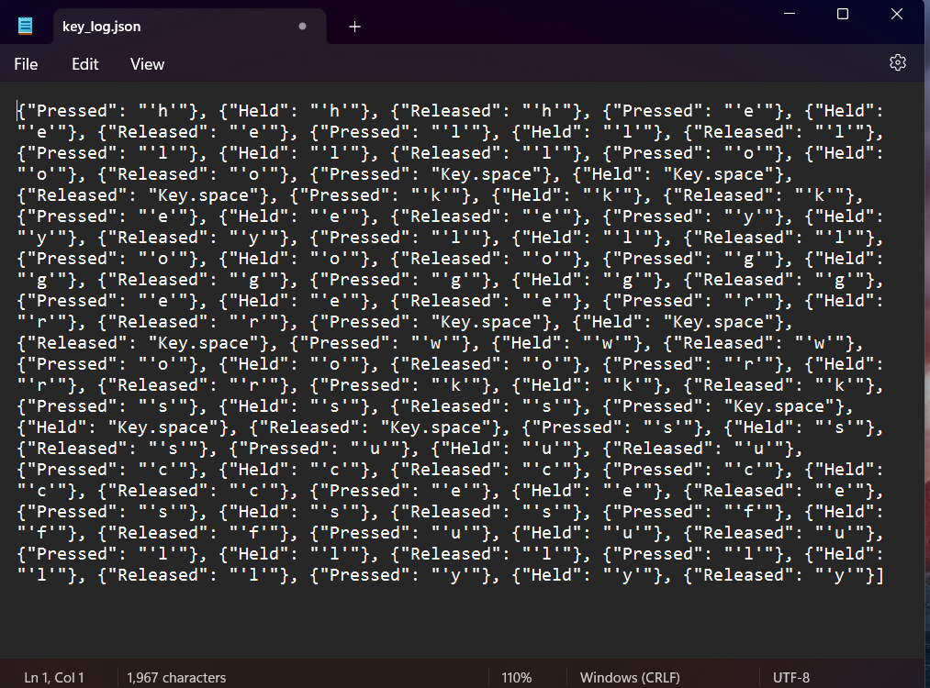
Outputs :
Keylogger .txt
Keylogger.jsons

Slide 14
RESULTS :
The implementation of keylogger that captures keystrokes and records them into both text and JSON files is successful.
The GUI provided a user-friendly way to control the keylogger, making it accessible and easy to use.
The keylogger project demonstrated the capability to effectively capture and log keystrokes in real-time.
Emphasized the ethical use of keyloggers and the importance of implementing security measures to protect against malicious use.
Real-time keylogging with start and stop functionality controlled via a simple GUI.
14

Slide 15
Project link :
GITHUB LINK OF PROJECT :
https://github.com/Peddamangari-Manoj/KEYLOGGER-AND-SECURITY.git

